Slide 1
Phase - 2
Phase 2. Option 1. ELT
Create empty staging table that matches the structure of the source dataset (deliverable 2.1.1)
Use Tableau Prep to (deliverable 2.1.2)
Rename at least one column
Show examples of data cleanup
Show example of filtering some data
Show example of creating calculated fields
Load the data to the staging tables in the database
Create SQL Insert statements to load data from staging tables to the normalized tables (deliverable 2.1.3)
Phase 2. Option 2. ETL
Use Tableau Prep to (deliverable 2.2.1)
Rename at least one column
Show examples of data cleanup
Show example of filtering some data
Show example of creating calculated fields
Load the data to the staging tables into normalized tables directly

Slide 2
Phase - 2 (Option 2. ETL)
In Phase 2 we learned about ETL and ELT, which are two different approaches
Phase 2, Option 1 involves performing ELT (Extract, Load, Transform) tasks using Tableau Prep and SQL as tools. The aim of this task is to prepare the data for further analysis and reporting. In ELT, Data is extracted from a variety of sources and loaded into a target system during the ELT process. When the data has been put into the target system, it is changed using tools like SQL or data modelling tools. When the target system has the processing power to handle massive amounts of data and the transformation logic is relatively straightforward, ELT is frequently utilized
Phase 2, Option 2 involves performing ETL (Extract, Transform, Load) tasks using Tableau Prep as a tool. The aim of this task is to prepare the data for further analysis and reporting. In ETL, Data is taken from several sources, transformed to adhere to a certain data model or schema, and then put into a data warehouse or other destination system during the ETL process. Data from several sources is cleaned, mapped, and combined during the transformation stage so that it can be combined into a single, coherent perspective. When dealing with enormous amounts of data that need to be processed extensively before being placed into a data warehouse, ETL is frequently utilized

Slide 3
Phase - 2 (Option 2. ETL)
After a brief discussion with the team, we decided to go with Option 2, ETL (Extract, Transform, Load).
In deliverable 2.2.1, several tasks are performed using Tableau Prep. These tasks include:
Renaming at least one column:
Here we have renamed couple of columns such as “MOTM” to “Man of the Match”, ”MOTS” to “Man of the series” and “Series Win” to “Series Victory”
Data clean-up: This involves removing or correcting any errors or inconsistencies in the data. For Example:
Here we have Grouped Duplicate values for column “Ind Captain” and replaced it with the correct value, for “mohd. Azharuddin” which is Replaced by “Mohd. Azharuddin”, “michael Kasprowicz” Replaced by “Michael Kasprowicz” and “steve Waugh” Replaced by “Steve Waugh”

Slide 4
Phase - 2 (Option 2. ETL)
“Team Total” column is Split into two Columns, “Runs Per Innings” & “Wickets Fallen”
Changing the Data types of “Runs Per Innings” & “Wickets Fallen” Columns from String to Numeric
Creating calculated fields: This involves creating new columns of data by performing calculations on existing data. For Example:
Here, the values “ri”, “r”, “w” is Replaced by “Runs + Innings”, “Runs” & “Wickets” using calculated fields
Filtering data: This involves selecting only specific rows of data that meet certain criteria. For example:
We filtered out Non-Null values from the column “Wickets by best bowler” as it won’t harm the data
We then removed the column of “Team Total” as it was redundant data

Slide 5
Phase - 2 (Option 2. ETL)
We filtered the “Winner” column and kept only “India” & “Australia” Value
We Excluded “Drawn” Value from the column “Series Victory”
We removed two Calculations columns which we created for “Win Margin” and kept only single column named “Win Margin Descriptive”
After all the Clean-ups and Filtering, we then divide our Dataset into 5 Different tables. “Top Scorer,” “Innings Records”, “Streak Achievement”, “Match Narration” & “Match Location”
Top Scorer: This table has columns named “Highest Scorer” & “Team”
Innings Records: This table has columns named “Test Series Year”, “Test Number”, “Innings”, “Highest Scorer”, “Runs by Highest Scorer”, “Best Bowler”, “Wickets by Best Bowler”, “Runs per Innings” & “Wickets Fallen”
Streak Achievement: This table has columns named “Test Series Year”, “Man of the Series” & “Series Victory”
Match Narration: This table has columns named “Test Series Year”, “Test Number”, “Venue”, “Winner”, “Win Margin Descriptive”, “Man of the Match”, “Ind Captain” & “Aus Captain”
Match Location: This table has columns named “Venue” & “Host”

Slide 6
Phase - 2 (Option 2. ETL)
After division of 5 tables, we created aggregations for each of the 5 tables. By doing this we will have unique values in all the tables. These aggregated results can be used to export to other formats for further analysis such as SQL Server.
Connecting Data into SQL: To connect to data in SQL, you need to establish a connection to a database server that hosts the data you want to access. The exact steps for connecting to data in SQL will depend on the specific database management system (DBMS) you are using. However, for this flow the following steps are:
After the completion of the flow, select output and select the “save to Database” option
On the settings menu under the option table, select the required table name
Select an option to create or update your output table. Here you will find three options Create table, append to table, and Replace data
Select append to table, it will add data to existing table. If the table does not exist, it will be created when we first run the flow from the Tableau Prep.
Note: We Repeated the above steps for all the 5 tables created

Slide 7
Phase - 2 (Option 2. ETL)
Once the data is loaded into the SQL Server and the tables, we ran the “Select” Query to show few rows from the respective tables to check the data is loaded. The following tables are:
Innings_Records
Match_Location
Match_Narration
Streak_Achievement
Top_Scorer
Note: The SQL files which are run for this are attached in the submission file.

Slide 8
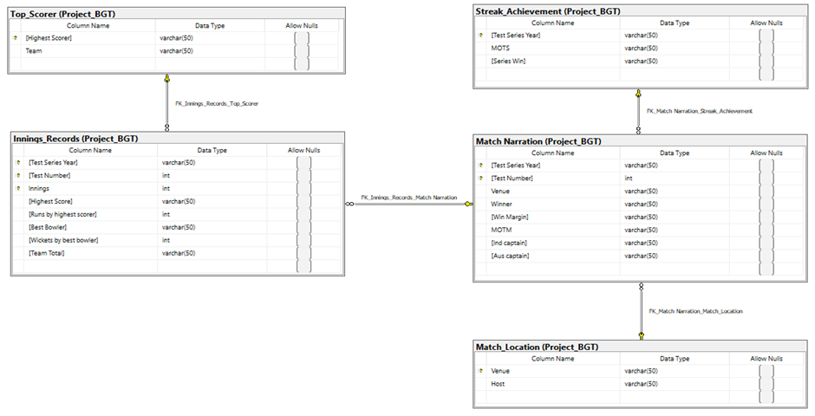
Phase - 2 (Option 2. ETL)
Physical Data Model with Entities Diagram:
The above Diagram is the one before the Clean-up and Filtering Process was done.

Slide 9
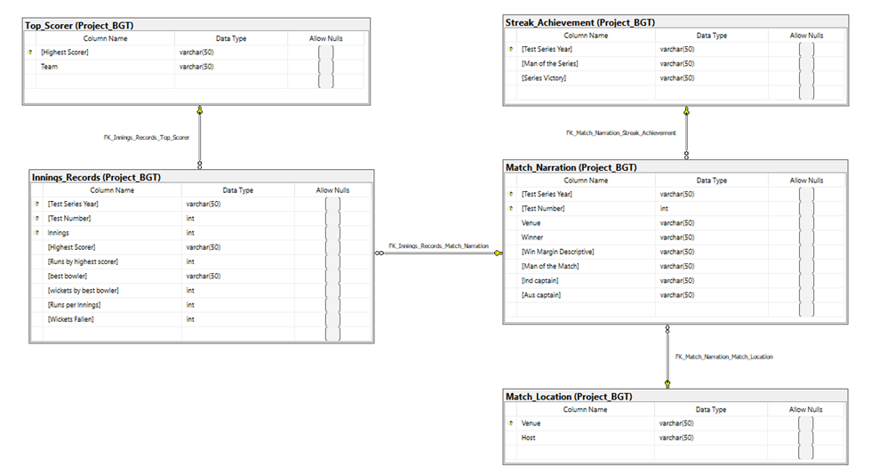
Phase - 2 (Option 2. ETL)
Physical Data Model with Entities Diagram:
This Diagram is the one after we did all the Clean-ups, Filtering, and loading process.

Slide 10
Phase - 2 (Option 2. ETL)
These contains some following changes such as:
“Streak_Achievement” table’s column “MOTS” was renamed to “Man of the Series” & “Series Win” to “Series Victory”
“Innings_Records” table’s column “Team Total” was split into two columns named “Runs per innings” & “Wickets Fallen”
“Match_Narration” table’s column “MOTM” was renamed to “Man of the Match” & “Win Margin” column values were changed using calculated field and the column was renamed as “Win Margin descriptive”
At last, we merge all our normalized tables using Join Query as one table and match our data with our original dataset. The SQL query file “Merged DataSet from Normalized Table” is added in the submission file

